Slide 1
Basics of Large Multimodal Models
EECS 598 Sys for GenAI
Presentation
Jan 23, 2024
Presentor(s)
Shiqi He
Aakash Puntambekar
Yong Seung Lee

Slide 2
Agenda
Background
Data Modalities
Multimodal Tasks
Vision-Language Understanding
Generation
CLIP: Contrastive Language-Image Pre-training
CLIP Architecture
Flamingo
Architecture
Training
Related Work: OpenFlamingo
Flamingo vs CLIP
LVLM Status Quo
BLIP2
LLaVA, MiniGPT-4, DeepSpeed-VisualChat
Discussion

Slide 3
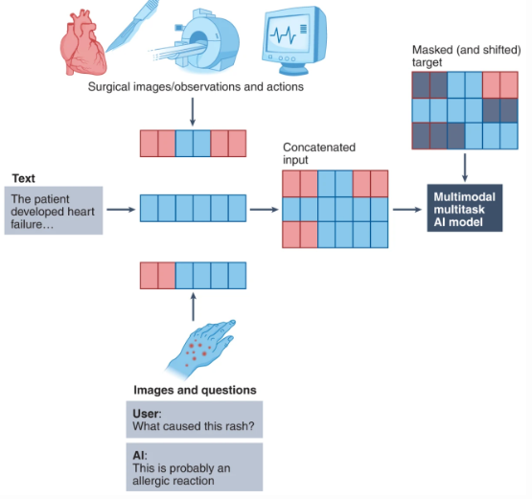
Data Modalites
Modality refers to modes of data
Image, text, audio, etc.
Video can be considered a combination of image and audio data
Human intelligence incorporates many different modes of data to synthesize concepts
ML models used to operate in only one mode of data
Large language models (LLMs) can be extended to include additional modes of data
This makes them Large Multimodal Models (LMMs)
Many LMMs have been released in the past year
ChatGPT, Flamingo and CLIP are all LMMs
Models capable of handling different data modes could be useful in many industries
Notes:
Audio, video data
https://paul.mou.dev/posts/2023-12-31-listening-with-llm/

Slide 4
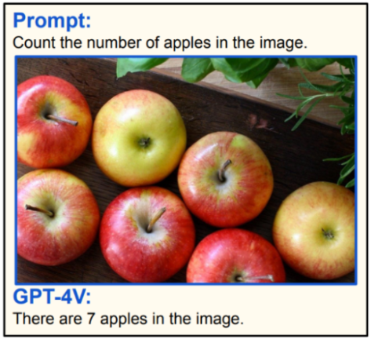
Multimodal Tasks
What makes a model multimodal? Any of the following:
Input and output are of different modalities (text to image, or vice versa)
Inputs are multimodal (e.g. able to process both text and images)
Outputs are multimodal
A model does not need to include a language model component to be considered an LMM
Multimodal tasks can be divided into two groups
Generation (e.g., stable diffusion)
Vision-language understanding (anything that doesn’t require generation)
There is some overlap, as generation requires understanding

Slide 5
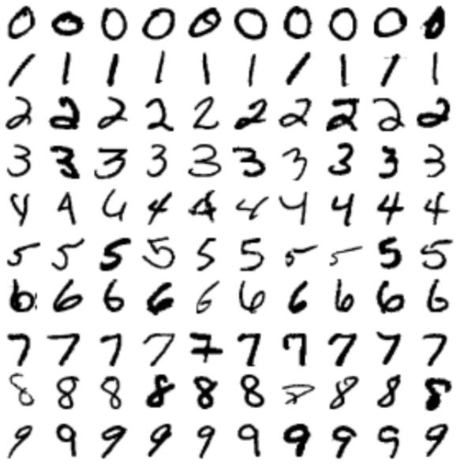
Vision-Language Understanding
Classification
Classification models can only produce outputs from a preset list of classes
An optical character recognition (OCR) model only needs to classify an input from a list of known characters
Text-based image retrieval
Search for images given a text query using only captions or metadata attached to the images
Given a text query, search in a trained embedding space across both images and text (more versatile)

Slide 6
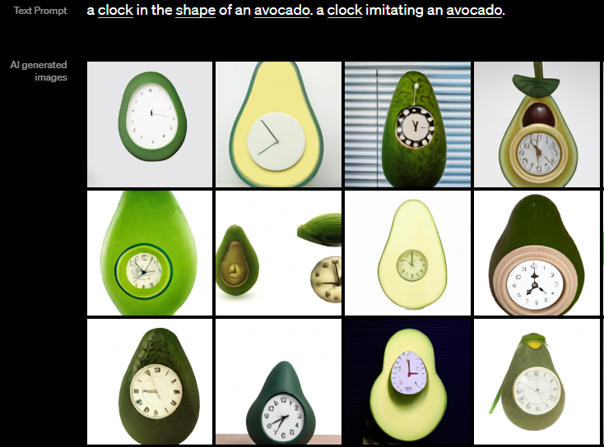
Generation
Image generation
Dall-E, Stable Diffusion and Midjourney are all examples of this
Text generation
One common task is visual question answering, e.g. input an image and ask “How do I make this dish?”
Another use is live image captioning
Example of image generation from Dall-E

Slide 7
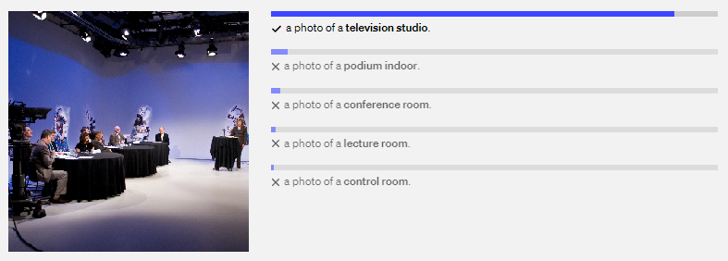
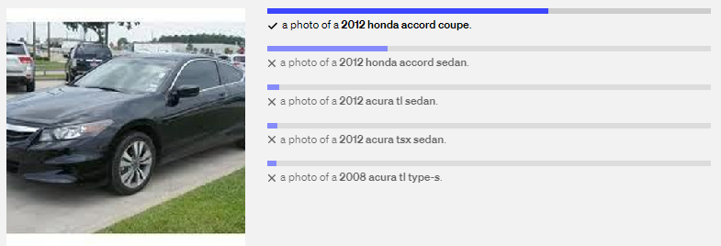
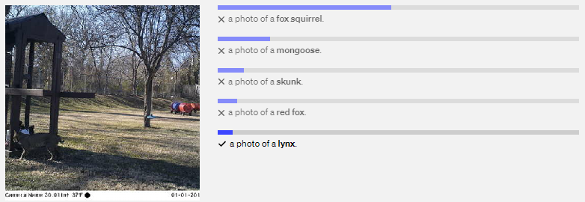
CLIP
Contrastive Language-Image Pre-training (CLIP)
Main contribution: able to map different modalities into a shared embedding space
Competitive zero-shot performance on many image classification tasks
Note that CLIP is classification, not generation
Examples of CLIP zero-shot performance
Notes:
A multimodal system has the following components:
An encoder for each data modality to generate embeddings
A way to align embeddings of different modalities
For generative models, a language model to generate text responses

Slide 8
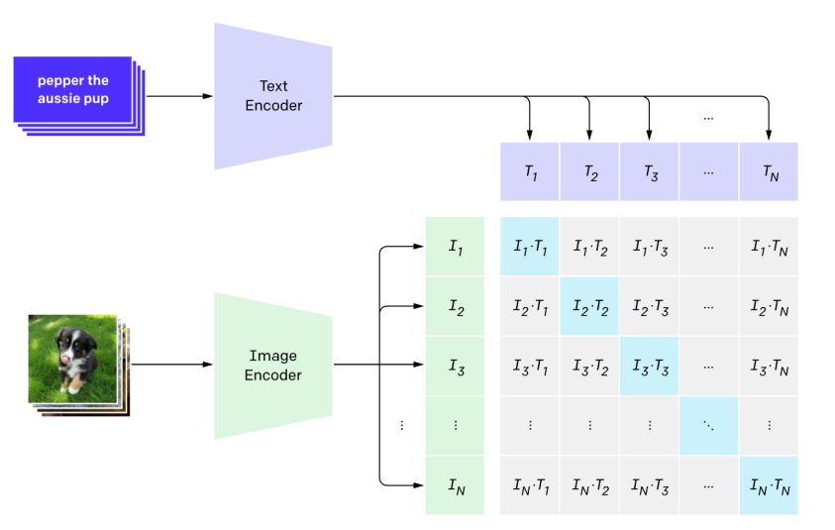
CLIP Architecture
Contrastive Language-Image Pre-training (CLIP)
Main contribution: able to map different modalities into a shared embedding space
Trains both image and text encoders together

Slide 9
Flamingo: a Visual Language Model for Few-Shot Learning
Deepmind

Slide 10
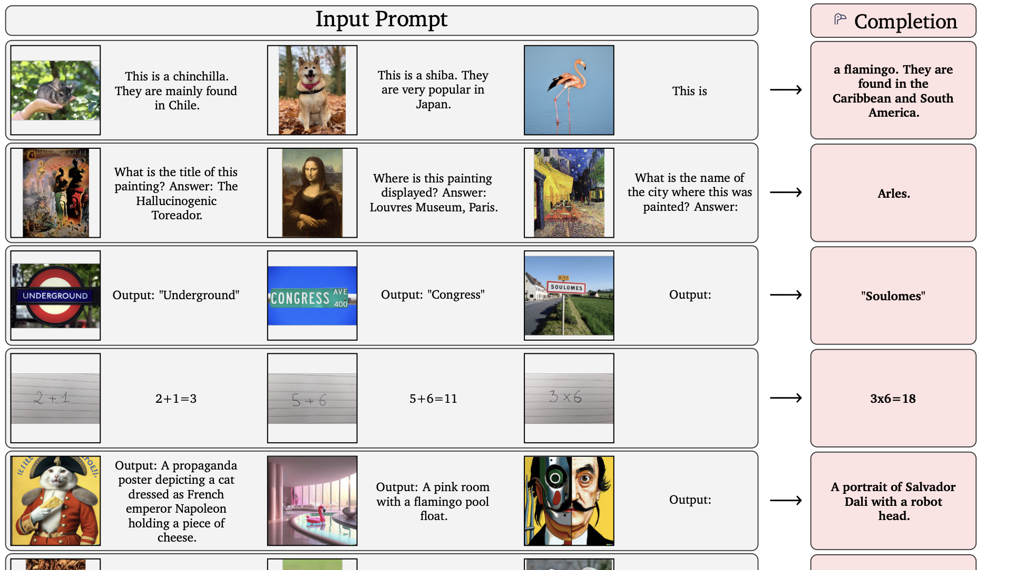
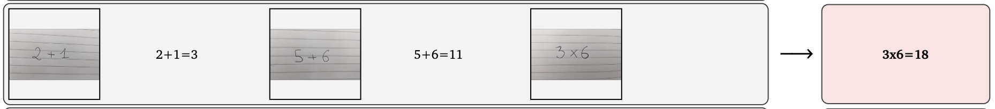
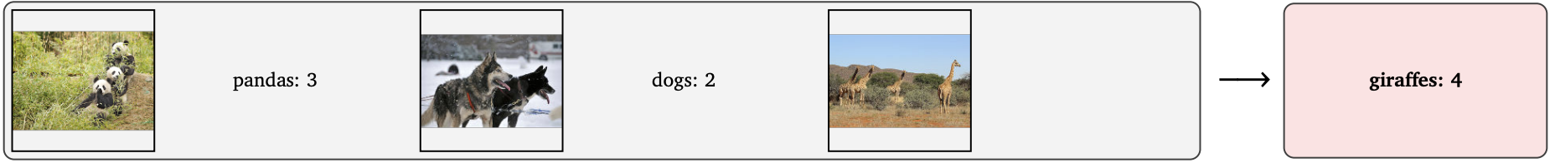
What is it?
Jan 23, 2023
Input: Mixture of Gif/image/text Output: text
Few-shot learning: Give couple examples, then it can answer the prompt.
Generalist: Can address multiple tasks (captioning, dialogue, classification)
Notes:
Why visual encoders and textual decoders?

Slide 11
Context
Vision Encoder
(Clip, ALIGN, Coca…)
LLM
(GPT3, Chinchilla, …)
Perception
Reasoning
FLAMINGO

Slide 12
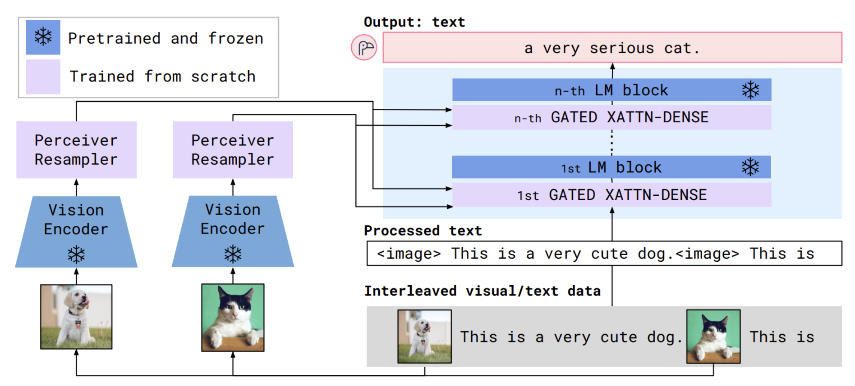
Overall Architecture

Slide 13
Why freeze?
Cheaper training cost: Save lots of memory (no need to save gradients to update those parameters)
Performance benefit: Prevent them from forgetting previously learned components.

Slide 14
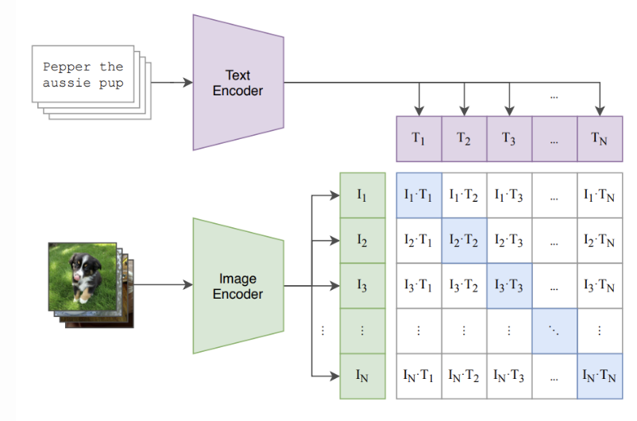
Pretrain - Vision Encoder
Keeping this part

Slide 15
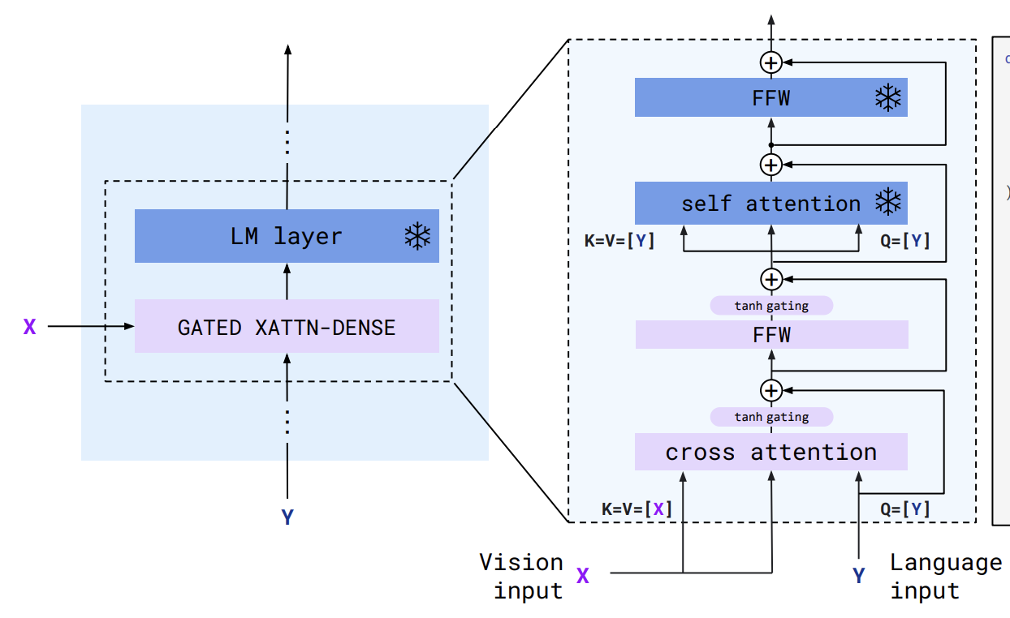
Pretrain - Language Model
Predict next token based on preceding tokens
Using Chinchilla for LM block

Slide 16
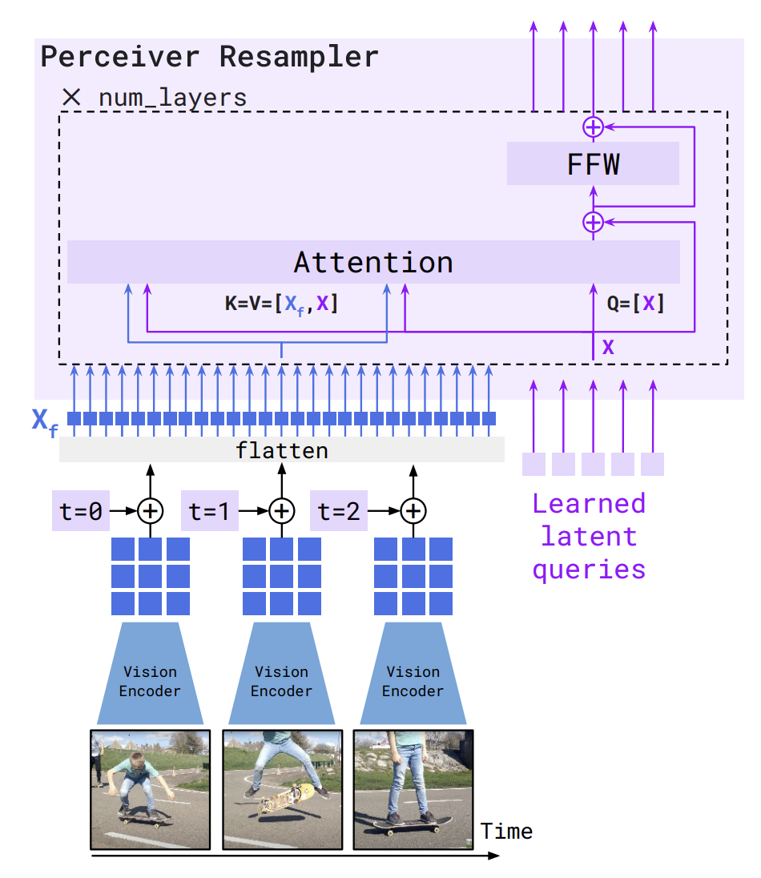
Train - Perceiver Resampler
Problem: various input (image, text, gif), and variable number of features.
Outputs fixed number of visual tokens
Takes variable number of features

Slide 17
Train - GATED XATTN-DENSE
Condition LM model with visual information
One layer before each LM block
Notes:
To ensure that at initialization, the conditioned model yields the same results as the original language model, we use a tanh-gating mechanism

Slide 18
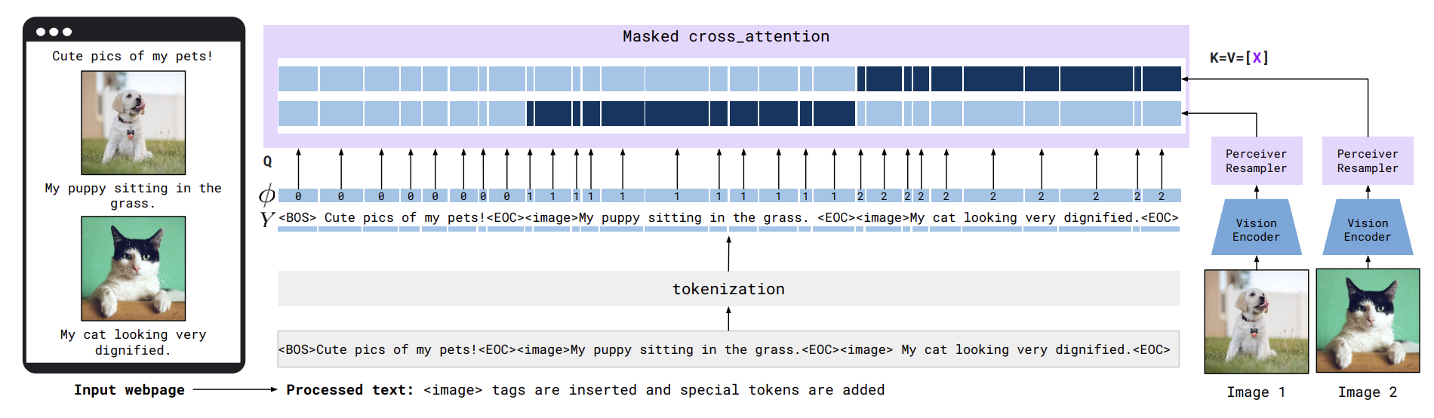
How to deal with interleaved sequence?
Cross-attend texts with preceding images by masking.
As it go through LM layers, it will incorporate other images too.
If lots of examples (image, text pair) are included, memory & computation heavy

Slide 19
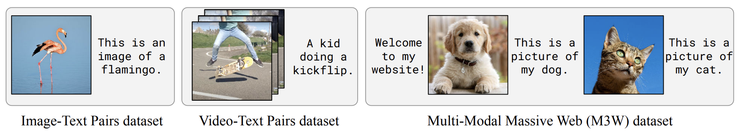
Training
Data
Goal
Flamingo computes the likelihood of text y conditioned on the interleaved images and videos x
Which text is more likely to get interleaved with this image/video?

Slide 20
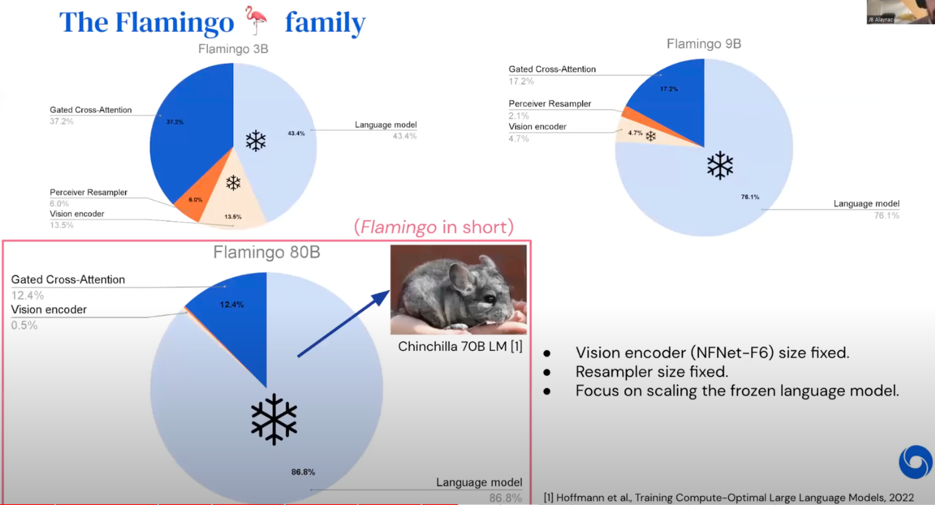
Flamingo Family
Scalability depends on Language Model (pretraining).

Slide 21
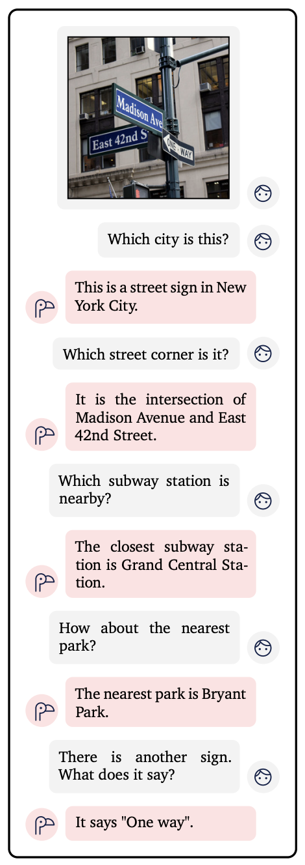
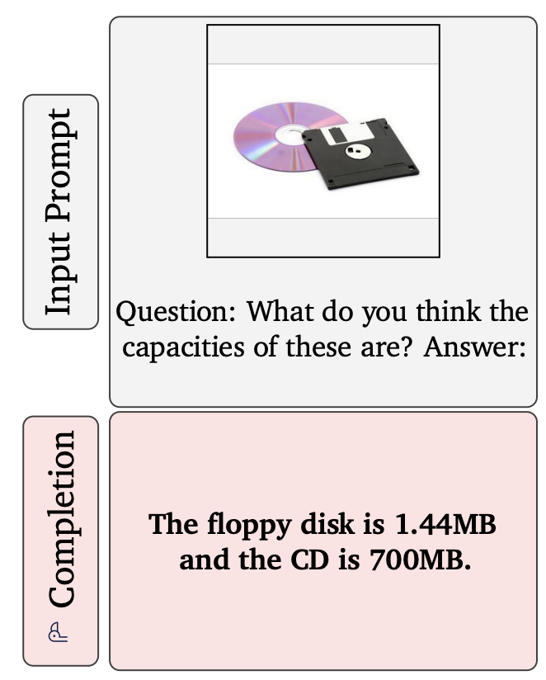
More than a few-shot
Zero-shot : inherited from Clip Dialogue

Slide 22
Limitations
Classification performance is not as good as state of the art.
Hallucinations (inherited from LM)
Needs hinting to understand complex scenes (lack of spatial understanding)
Context learning: memory issue if we give too many examples like 1000, also performance starts to get saturated as we put lots of examples.
One cross attention layer per each LM block. # computation increases linearly

Slide 23
Large Vision-Language Models
Status Quo

Slide 24
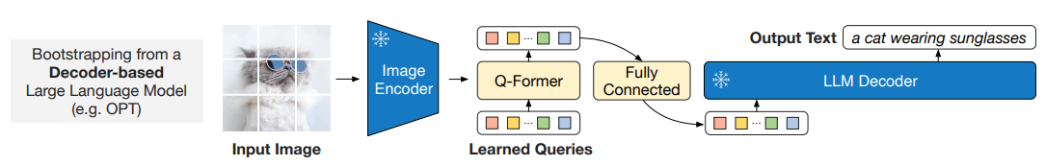
LVLM - BLIP2
BLIP2: Bootstrapping Language-Image Pre-training¹
Salesforce Research - Jan 2023
More efficient vision-text interactions
Trainable parameters 100M~1.1B (1.4B~10.2B for Flamingo)
Vision encoder - CLIP-ViT-g-14
Language decoder - FlanT5-XL
¹BLIP-2: Bootstrapping Language-Image Pre-training with Frozen Image Encoders and Large Language Models, 2023

Slide 25
LVLM - BLIP2
BLIP2 Architecture
Q-former (Querying Transformer)
Fully connected layers
Image embeddings and learnable queries as input
Extract the most useful visual feature
Notes:
What are queries?

Slide 26
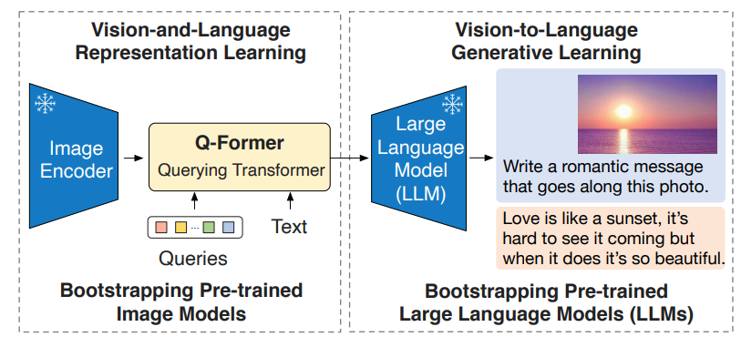
LVLM - BLIP2
Two-stage Pre-training
Representation learning from a frozen image encoder
Vision-to-language generative learning
Notes:
What are the training processes

Slide 27
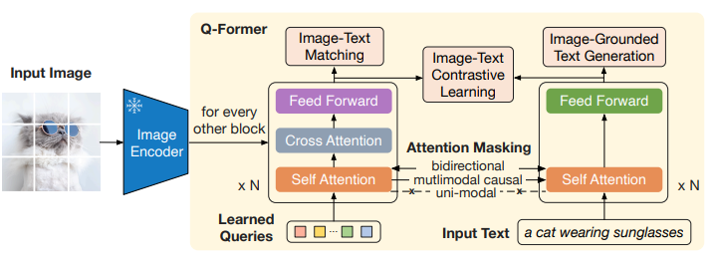
LVLM - BLIP2
Querying Transformer (Q-Former) - Representation learning
Three objectives
Image-Text Contrastive Learning
Image-grounded Text Generation
Image-Text Matching

Slide 28
LVLM - BLIP2
Querying Transformer (Q-Former) - Representation learning
Three objectives
Each objective employs a different attention masking strategy
Mask strategy controls interactions between queries and text
The text input here is for training not inference
Notes:
Why this attention mechanism saves computation cost?

Slide 29
LVLM - BLIP2
Fully Connected Layer - Generative Learning
We now have a pre-trained Q-former with learned queries
Project the query embeddings into the same dimension as the text embedding
Pre-train with the language modeling loss

Slide 30
LVLM - BLIP2
Training Cost
CLIP - Frozen visual encoder
RN50x64 - 592 V100 GPUs - 18 days
ViT - 256 V100 GPUs - 12 days
Flamingo
TPUv4 instances
80B - 1536 chips - 15 days
BLIP2
A single 16-A100(40G) machine
ViT-g and FlanT5-XXL
First stage - 6 days
Second stage - 3 days

Slide 31
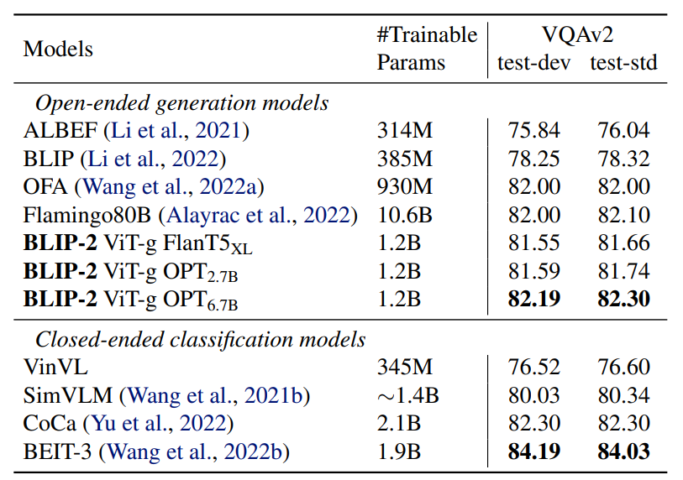
LVLM - BLIP2
Evaluation
Better zero-shot performance comparing with Flamingo
With 1B trainable parameters
Notes:
Add some examples of tasks
9% ??
Image-to-text generation? Need to add

Slide 32
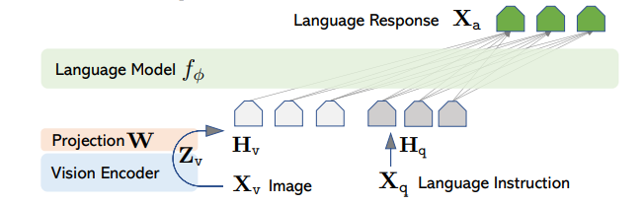
LVLM - LLaVA
LLaVA: Large Language and Vision Assistant¹
UWisc - Microsoft Research - Apr 2023
Visual instruction tuning with Instruction-following Data
LLaVA Architecture
Frozen vision encoder (e.g., CLIP ViT)
Frozen language model (e.g., Vicuna)
¹Visual Instruction Tuning, 2023
Notes:
Add paper names

Slide 33
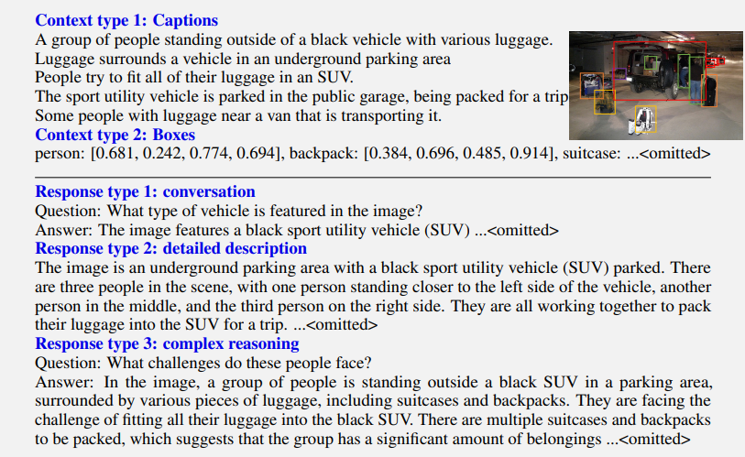
LVLM - LLaVA
Prepare Dataset
Convert images to symbolic representations
Captions
Boxes
Use symbolic representations to query GPT
Conversation
Detailed description
Complex reasoning
158K language-image instruction-following data
58k - conversation
23k - detailed description
77k - complex reasoning
Notes:
Training process

Slide 34
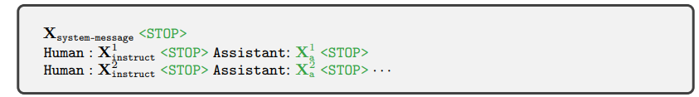
LVLM - LLaVA
Two-stage Instruction-tuning
Stage 1. Pre-training for feature alignment - Train projection layer
CC3M
Stage 2. Fine-tuning End-to-End - Train both projection layer and LLM
Multimodal chatbot
Science QA
Notes:
Training process

Slide 35
LVLM - LLaVA
Training Cost
CLIP - Frozen visual encoder
RN50x64 - 592 V100 GPUs - 18 days
ViT - 256 V100 GPUs - 12 days
Flamingo
TPUv4 instances
80B - 1536 chips - 15 days
BLIP2
A single 16-A100(40G) machine
ViT-g and FlanT5-XXL
First stage - 6 days
Second stage - 3 days
Cont.
LLaVA
8 x A100 GPUs
First stage - 4 hours
Second stage - 10 + 4 hours
No attention in projection!

Slide 36
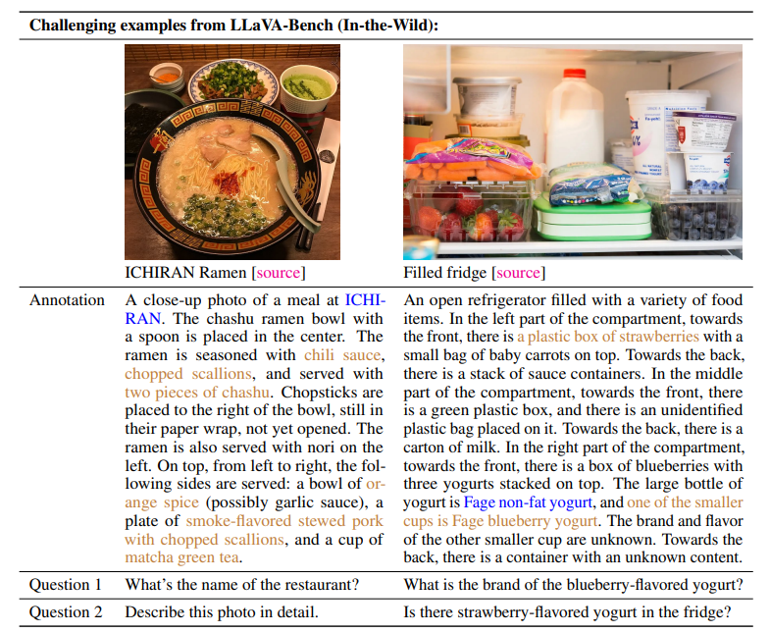
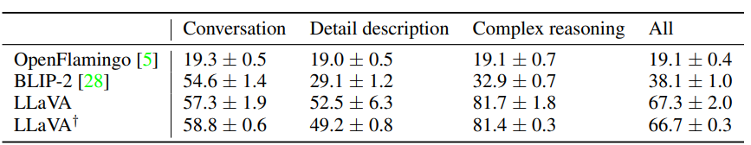
LVLM - LLaVA
Evaluation
Better instruction-following capability on dataset – In-the-Wild
OpenFlamingo
BLIP-2
Example - Image Annotation
Notes:
Add text. What are the advantages?

Slide 37
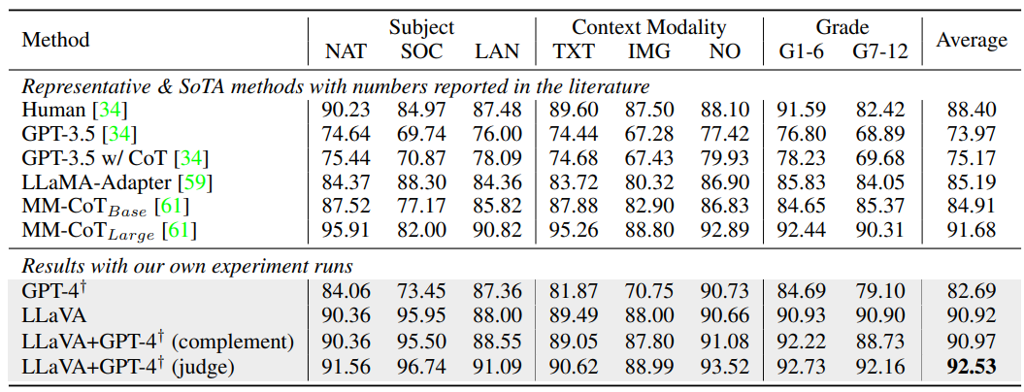
LVLM - LLaVA
Evaluation
Good performance on Science QA dataset - Multiple Choice Questions
NAT = natural science, SOC = social science, LAN = language science
TXT = text context, IMG = image context, NO = no context
Notes:
Add text. What are the advantages?

Slide 38
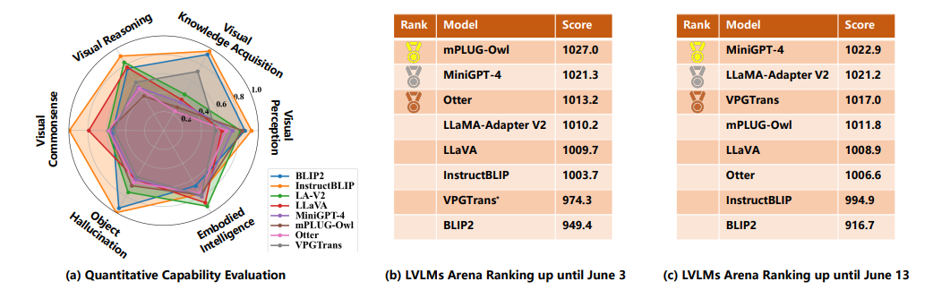
LVLM - MiniGPT-4
MiniGPT-4: The most powerful/popular open-sourced LVLM¹²
KAUST - Apr 2023
¹MiniGPT-4: Bootstrapping Language-Image Pre-training with Frozen Image Encoders and Large Language Models, 2023 ²LVLM-eHub: A Comprehensive Evaluation Benchmark for Large Vision-Language Models, 2023
Notes:
Add some survey papers. Minigpt-v2, LVLM-ehub, MME

Slide 39
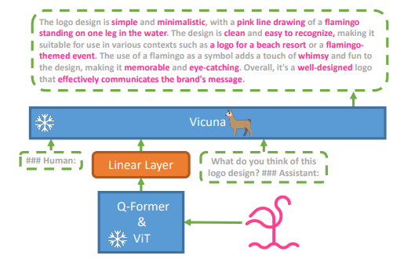
LVLM - MiniGPT-4
Architecture
Bridging the gap between vision encoders and LLMs with one projection layer
Vision encoder - ViT & Q-Former from BLIP-2
Language encoder - Vicuna

Slide 40
LVLM - MiniGPT-4
Two-stage Fine-tuning
First pre-training stage
Acquire vision-language knowledge from a large collection of aligned image-text pairs
Output of project layer as a soft prompt
Generate the corresponding ground-truth texts
Second fine-tuning stage with predefined prompts using templates
Curated a detailed image description dataset
Various forms of instructions
“Describe the image in detail”
“Could you describe the content of this image”
Notes:
Why visual encoders and textual decoders?

Slide 41
LVLM - MiniGPT4
Training Cost
CLIP - Frozen visual encoder
RN50x64 - 592 V100 GPUs - 18 days
ViT - 256 V100 GPUs - 12 days
Flamingo
TPUv4 instances
80B - 1536 chips - 15 days
BLIP2
A single 16-A100(40G) machine
ViT-g and FlanT5-XXL
First stage - 6 days
Second stage - 3 days
Cont.
LLaVA
8 x A100 GPUs
First stage - 4 hours
Second stage - 10 + 4 hours
No attention in projection!
MiniGPT-4
4 x A100 GPUs
First stage - 10 hours
Second stage - 7 min on 1 x A100

Slide 42
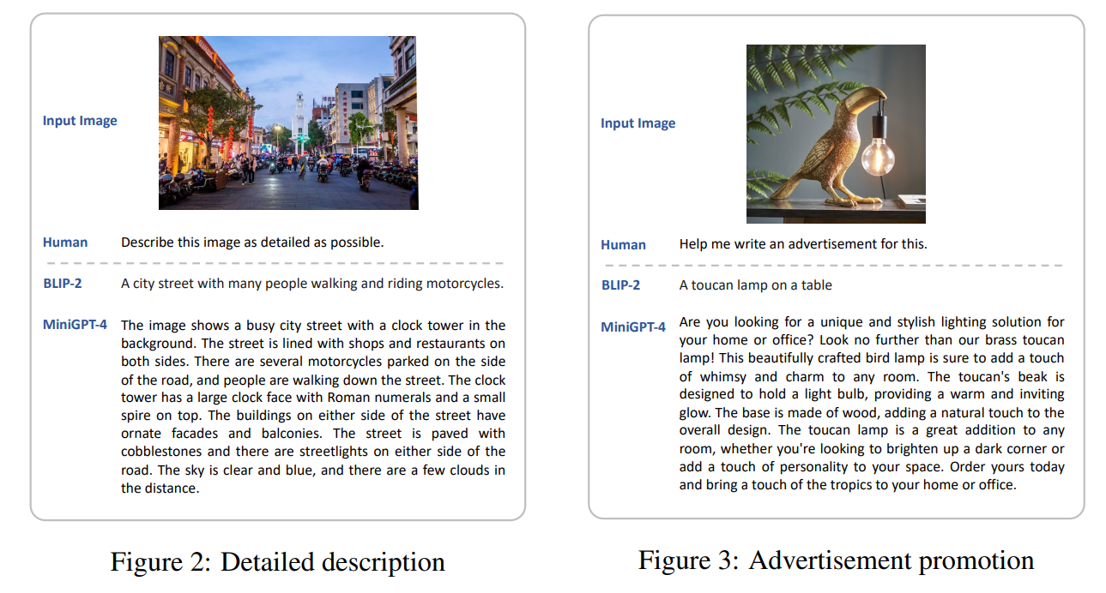
LVLM - MiniGPT-4
Evaluation
Detailed description
Notes:
Add more text

Slide 43
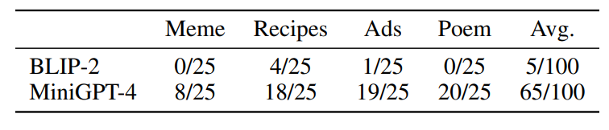
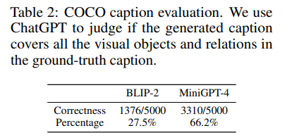
LVLM - MiniGPT-4
Evaluation
Meme interpretation, Cooking Recipes, Poem writing, and Advertisement
Notes:
Add more text

Slide 44
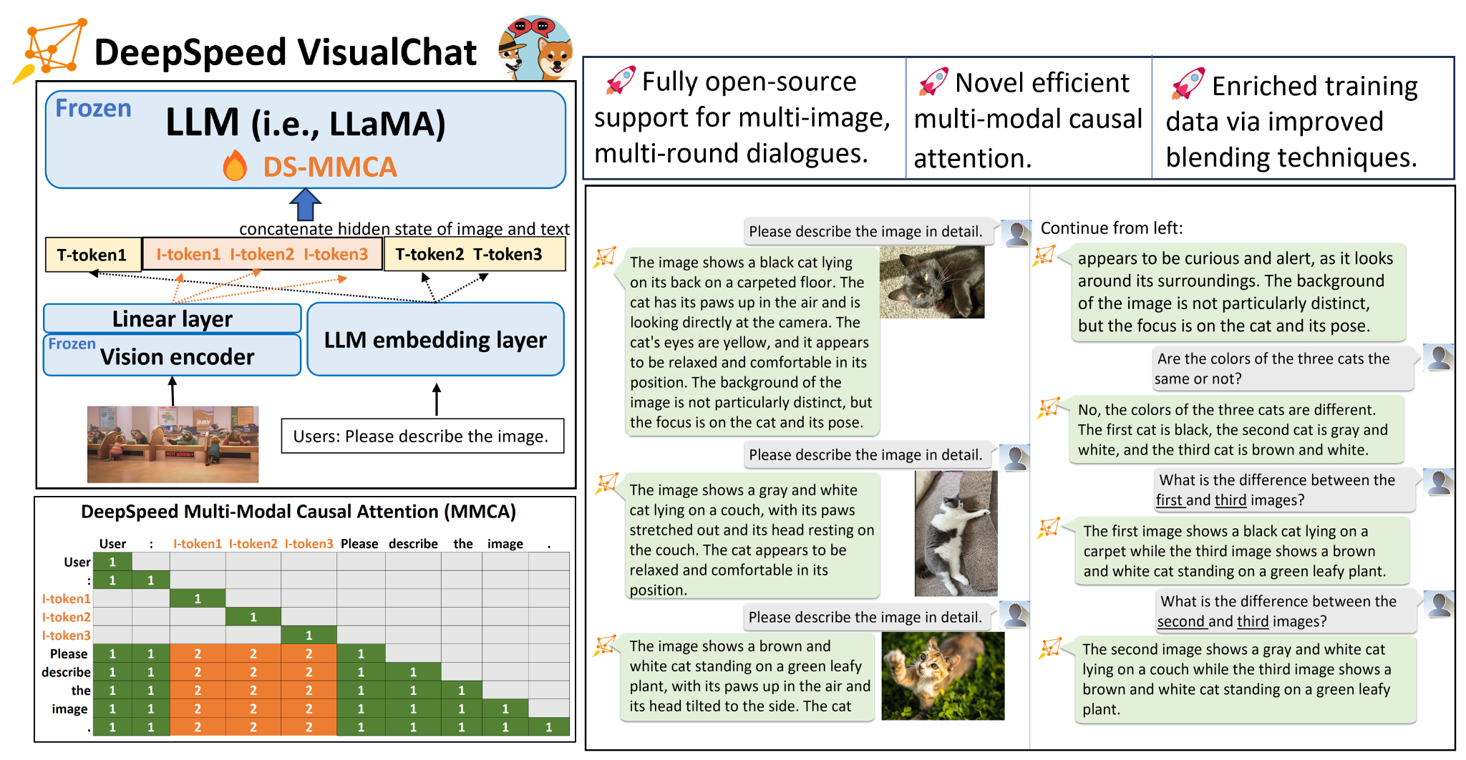
LVLM - DeepSpeed-VisualChat
DeepSpeed-VisualChat¹
DeepSpeed of Microsoft - Oct 2023
Multi-round multi-image tasks
¹DeepSpeed-VisualChat: Multi-Round Multi-Image Interleave Chat via Multi-Modal Causal Attention, 2023

Slide 45
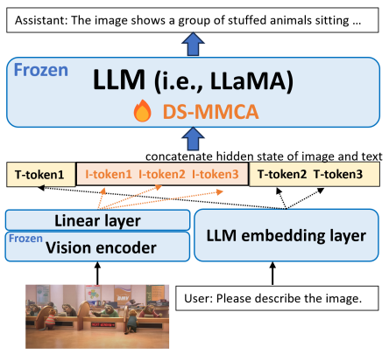
LVLM - DeepSpeed-VisualChat
DeepSpeed-VisualChat - Architecture
Frozen vision encoder
Frozen language model
Image projected through a linear layer
Align with text embedding
Output are merged

Slide 46
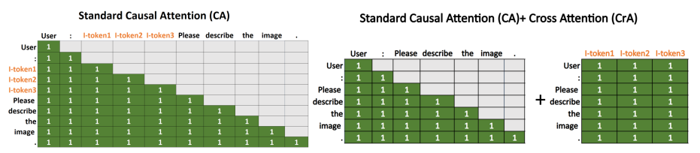
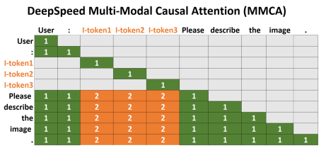
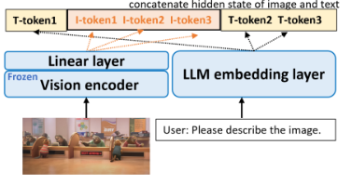
LVLM - DeepSpeed-VisualChat
Multi-Modal Casual Attention (MMCA)
Image - attend to themselves
Text - two separate attention matrices - one for previous text, one for image
Notes:
Flamingo, why this gives a better multi-round abilities

Slide 47

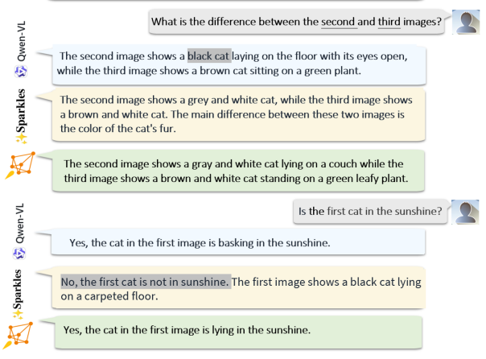
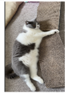

LVLM - DeepSpeed-VisualChat
Training cost not available
Demo Results (Grey Area - Mistake)
Notes:
Flamingo, why this gives a better multi-round abilities

Slide 48
LVLM - Discussion
Model-Centric
Flamingo
Gated cross attention
BLIP2 - causal attention
Q-former
DeepSpeed-VisualChat
Multi-Modal Causal Attention
Data-Centric
LLaVA
GPT-4 powered instruction-following data
MiniGPT-4
High-quality image-text dataset
Notes:
System challenges

Slide 49
LVLM - Discussion
How to build your own LVLM?
Architecture and attention mechanisms
Pre-training methods
Opportunities - LLaVA-1.5, MiniGPT-v2
Architecture and attention mechanisms
Resource consumption
Computation intensity
Pre-training methods
Multiple training stages
Multiple training objectives
Multiple images and multi-round tasks
Gifs / videos
Notes:
System challenges

Slide 50
Thank You - Q & A
Choose Your Heros
CLIP - Frozen visual encoder
RN50x64 - 592 V100 GPUs - 18 days
ViT - 256 V100 GPUs - 12 days
Flamingo
TPUv4 instances
80B - 1536 chips - 15 days
BLIP2
A single 16-A100(40G) machine
ViT-g and FlanT5-XXL
First stage - 6 days
Second stage - 3 days
Cont.
LLaVA
8 x A100 GPUs
First stage - 4 hours
Second stage - 10 + 4 hours
No attention in projection!
MiniGPT-4
4 x A100 GPUs
First stage - 10 hours
Second stage - 7 min on 1 x A100
DeepSpeed-VisualChat
?

Slide 51
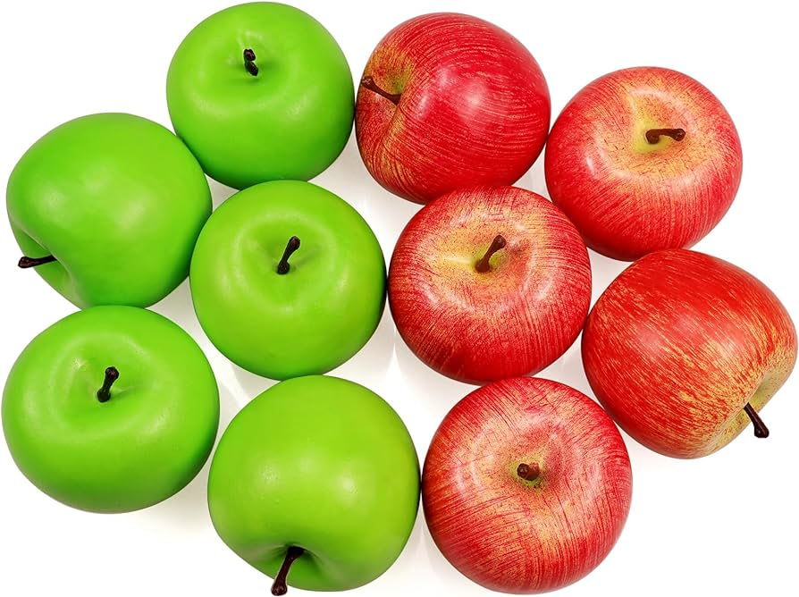
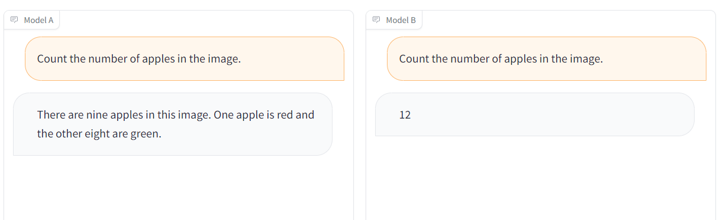
Counting

